Slide 1
Axon: Spiking Error Driven Learning
Randall C. O’Reilly

Slide 2
Advantages of Spikes vs. Rate Code
More graded dynamics with less momentum:
Constantly refreshed, vs. continual broadcast
“Balanced” between attractor, updating
Augment attentional foreground (synchrony) while still having lower-level background.
Also efficiency: reduced communication cost

Slide 3
“Raw” spikes are too porous
Basic AdEx (Brette & Gurstner) simply doesn’t “work”:
For any given input, every single neuron eventually fires in turn
For learning, need a specific representation for each input
Key fix: Add NMDA, GABA-B longer-term (~100 msec) bistability dynamics weakly

Slide 4
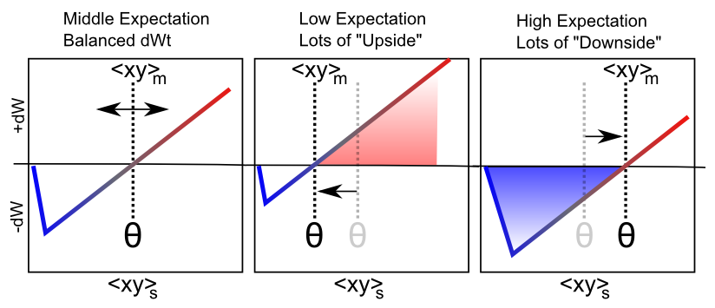
Same Leabra Error-Driven Learning Using Ca⁺⁺ Integrated over Spikes
dW = Outcome – Expectation = <xy>_{s} - <xy>_{m}

Slide 5
Longstanding “Hog” Problem
Positive feedback loops in bidirectionally connected networks kill larger networks: Hogs
Biology to the rescue:
Zero sum weight changes
Slowly changing “structural / spine” weights: give it a backbone
Per-neuron target average activity, adapting slowly (bias weights): Turrigiano et al

Slide 6
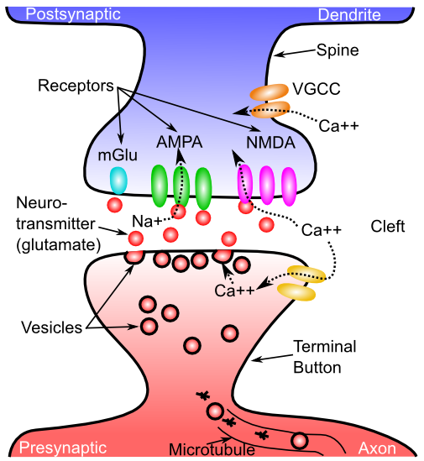
Spine is the backbone

Slide 7
It Works!

